Slide 1

Files in C
Data Structures
Dr. Bouchaib Falah

Slide 2
Why use files?
Storage of data in variables and arrays is only temporary (and limited)
As long as your program is running
Files are used for permanent storage of large amounts of data
“Permanent” really means long term
“Large” does not mean infinite
Files can be created, updated, and processed by C programs

Slide 3
Text & Binary File Processing
An external collection of data treated as a unit.
Text File: Continuous stream of characters broken into lines by the new-line character!
Binary File: Collection of Bits (0’s & 1’s)!
 The term “binary” is actually a misleading one as all files are stored in binary!

Slide 4
File Properties
File properties:
Name
Must be opened (Otherwise, you can not work with it)
Must be closed. (Once you are done with it, close it)
Can be written to.
Can read from.
Can be appended to.
 Like a BOOK!!!
How can these operations be carried out?

Slide 5
Accessing Files
Procedure for Accessing a file:
1. Declare a File Pointer
FILE *my_file_Pointer
2. Open the file & specify the Access mode (Read, Write, Append)
my_file_pointer = fopen(“My_data.txt”, “w \r \a \r+”)
W: Write; r: Read; a: Append; r+: Read & Write
3. Write/Read using fprintf/fscanf
4. Close the file
fclose(my_file_pointer)

Slide 6
Opening Files
Before accessing any file you must declare File_Pointers and give descriptive names to them.
File pointer for reading:
FILE *infp;
File pointer for writing:
FILE *outfp;

Slide 7
Opening Files
fopen: returns a file pointer!
fopen(“filename”, “mode”)
Creating a text file / opening a file for writing:
outfp = fopen(“data.txt”, “w”)
If the file does not exist, it will be created
If the file exists, it will be overwritten
Opening a text file for reading:
infp = fopen(“data.txt”, “r”)
If the file does not exist, fopen will return a NULL pointer
Useful  if (infp == NULL)printf(“File not found”);

Slide 8
Writing into a Text File fprintf
fprintf: The same syntax as printf, except that it takes one additional argument which is the file_pointer:
FILE *outfp;
outfp = fopen(“new_file”, “w”);
if (outfp == NULL) printf(“CANNOT OPEN FILE);
else fprintf(outfp, “Hell Mr. %s”, name);
fclose(outfp);

Slide 9
Reading from a Text File fscanf
“File_pointer” is the additional argument to scanf.
File *infp;
infp = fopen(“data.txt”, “r”);
if (infp == NULL) printf(“FILE NOT FOUND”);
else { fscanf(infp, “%s”, name);
printf(“The name in the file is: %s”, name); }
fclose(infp);

Slide 10
Practice: Exercise_1
Write a program that would
1) read your name from the keyboard and store it in a file.
2) Open the file, read the name stored in the file and store it into a variable then display it on the screen

Slide 11
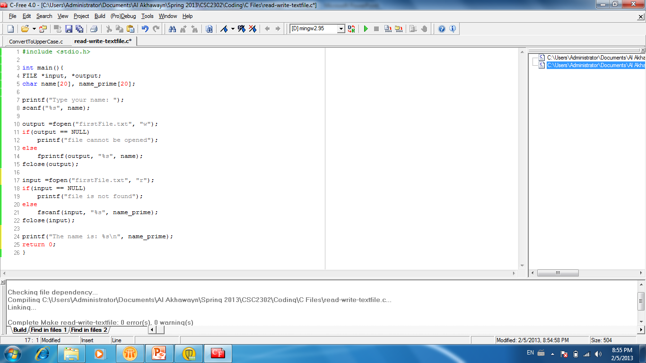
Practice: Exercise_1 Solution

Slide 12
Other functions for Read/Write
getc: gets a character from a file pointer
ch = getc(infp);
fgets: gets a string (one line- including spaces) from a file pointer
fgets(char *name, int n, FILE *infp);
reads (n-1) characters or till a newline is encountered
putc: writes one character into file
putc(char ch, FILE *outfp)
fputs: writes a string into a file
fputs(char *s, FILE *outfp)

Slide 13
Exercise_2
Write a program that:
Converts all file’s characters onto “Uppercase”
“Doublespaces” the file.
Hints:
The function islower(char ch) returns nonzero integer if ch is a lower. It is included in <ctype.h>
To convert from lower to upper use:
printf(“%c”, ch - 32);

Slide 14
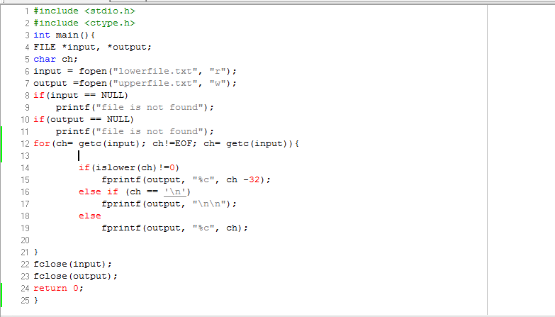
Exercise_2_solution

Slide 15
Binary files
Set of 0’s & 1’s. Why use binary files?
Save CPU time.
Illustration:
Writing an integer (123) into a binary file requires two Bytes. (16 bits): [00000000-01111011]-(A “Short” int)
Data is written directly from the memory to the file (One step)
Now if you use: fprintf(outfp, “%d”, i); i should be converted into characters first “123”: One additional step.
Thereafter, binary codes for the characters “1” “2” “3” should be written down. (3 bytes)
 So more time: Time for copying each character

Slide 16
Accessing Binary Files
The same procedure as for Text files applies:
1. Declare a file pointer:
FILE *infp_b
2. Open the file & specify the Access mode:
infp_b = fopen(“data.bin”, “wb”)
 a prefix “b” is added to the mode to specify binary.
3. Write/Read using fwrite/fread
4. Close the file:
fclose(infp_b);

Slide 17
Writing into a binary file “fwrite”
fwrite takes four arguments:
fwrite(array, sizeof(..), Max_Size, outfp_b)
1st arg: specifies the address of the first element to be copied (pointer to the information to be written)
2nd arg: specifies the size (in bytes) of the standard C data types (char, int, long,...)
Sizeof( data_type_elt): is a C built-in function that returns the size of Data_Type_Elt in bytes. Exp:
printf(“The size of a char is %d”, sizeof(char)); (1)
3rd arg: specifies the number of values to be written. “Here Max_size is the size of the array”.
4th arg: specifies the output file pointer.

Slide 18
“fwrite” Examples
Example_1:
fwrite(&ch, sizeof(char), 1, outfp_b)
This statement would copy one character held in the ch variable.
Example_2:
typedef struct {………………….} student;
student s1;
fwrite(&s1; sizeof(student), 1, outfp_b)
This statement would copy one structure of type student held in the s1 student-struct variable.

Slide 19
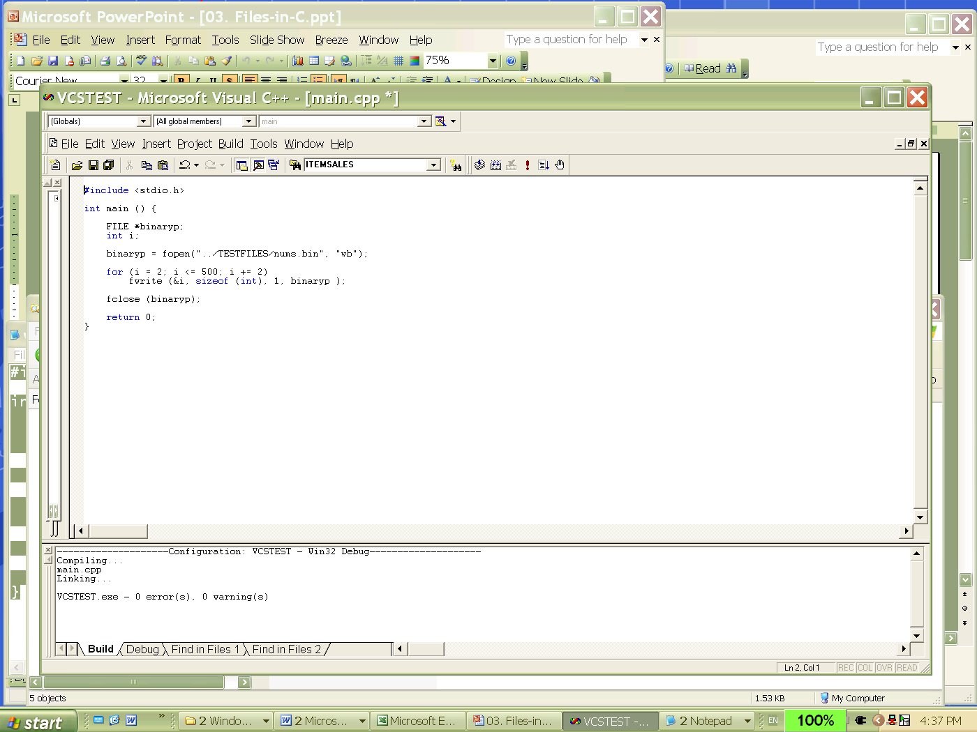
“fwrite” Examples
A code fragment for opening a binary file and writing a set of numbers to it
The built-in operator sizeof gives the size of any (named) type to find the number of bytes in the current implementation.

Slide 20
Reading from a binary file “fread”
fread takes also four arguments:
Example 1:
fread(&s1, sizeof(student), 1, infp)
 The arguments are the same as for fwrite
Example 2:
fread(&I, sizeof(int), 1, infp_b)
This statement would copy the correspondent number of bits of one integer value from the binary file to the integer variable i.
Example 3:
fread(array, sizeof(double), Max_Size, outfp)
This statement would fill the array with Max_Size elements of type double from the binary file

Slide 21
Reading/Writing to Binary Files
With fwrite and fread, you can write 1 value at a time (as in the example).
You can write multiple values of the same type:
E.g. if scores is an array of 10 integers fwrite(scores, sizeof(int), 10, binaryb) will write the whole array.

Slide 22
Reading/Writing to Binary Files
Similarly you can write a whole structure:
typedef struct { char name[10]; double diameter; int moons; double orbit_time, rotation_time; } planet_t; planet_t a_planet;
fwrite(&a_planet, sizeof(planet_t), 1, binaryp)
will write the whole structure.
Similarly you can write a whole array of planets.

Slide 23
Disdvantages of Binary Files
Cannot be examined in word processor
Cannot be modified outside the program that wrote it
Must know exactly how it was written to know how to read it.

Slide 24
Important Tips
Do not mix file types:
A file created using “fwrite” should be read using “fread”.
A file created using “fprintf” should be read using “fscanf”
fwrite returns the number of elements successfully copied: arg3
int fwrite(arg1, arg2, arg3, arg4); If no element is copied it returns Zero,
The same with fread, it returns the numbers of elements successfully read (arg3); If no element is successfully read, it returns Zero,

Slide 25
Exercise_4
1. Write a program that copies an Array of student structures from a text file then writes them into a binary file.

